Slide 1
Responses of animals to the biotic environment
Interspecific aggressive responses
Parasite- host relations

Slide 2
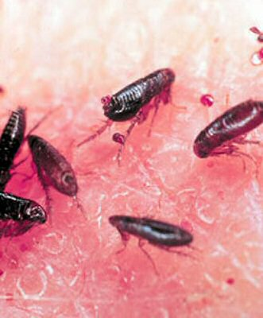
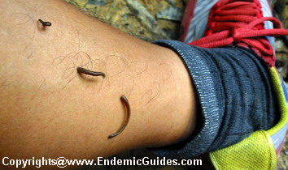
Parasites exploit their hosts for food.
Ectoparasites live on the outside of their host.
  Leeches and fleas suck our blood

Slide 3
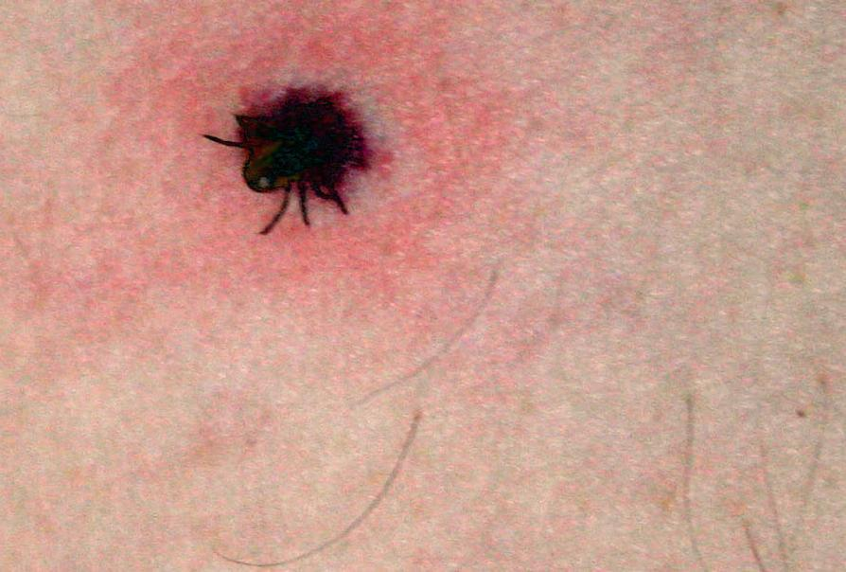

Ectoparasites continued -
Ticks burrow into your skin and have to be dug out

Slide 4
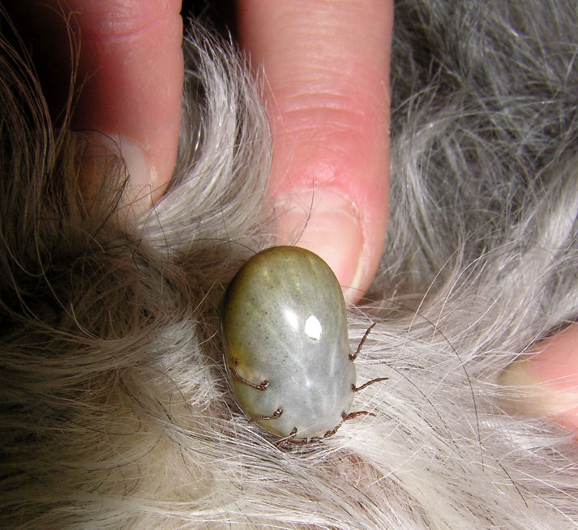
Ectoparasites continued – a dog tick

Slide 5
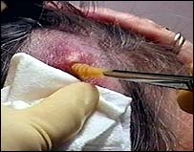
This is a bot fly larva being remover from Tania's head. She picked it up on a trip to Africa
NOOOOOOO!!!

Slide 6
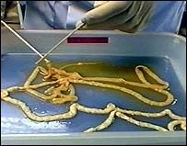
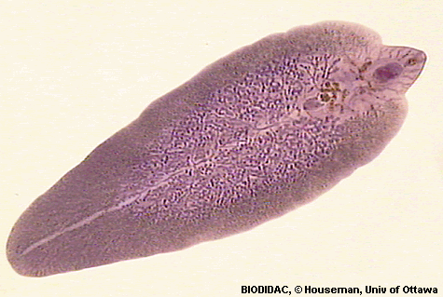
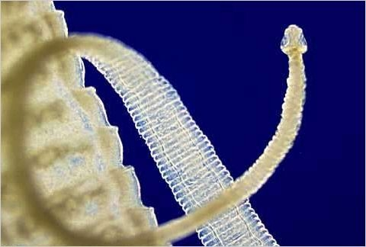
Endoparasites live inside their host
This is one tapeworm
This is a liver fluke

Slide 7
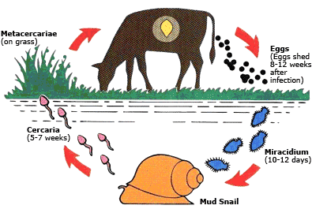
Liver fluke

Slide 8
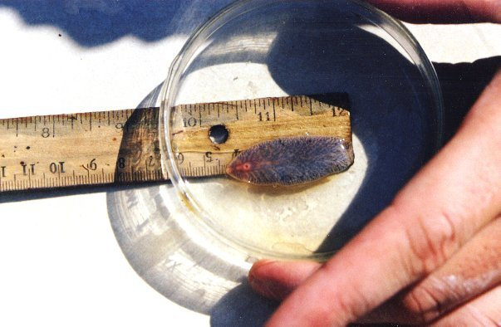

Slide 9
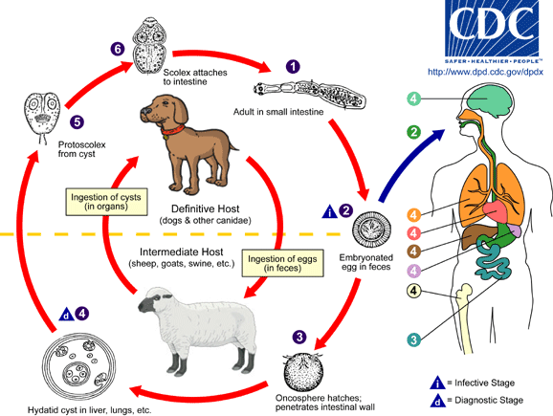
Hydatid tapeworm

Slide 10
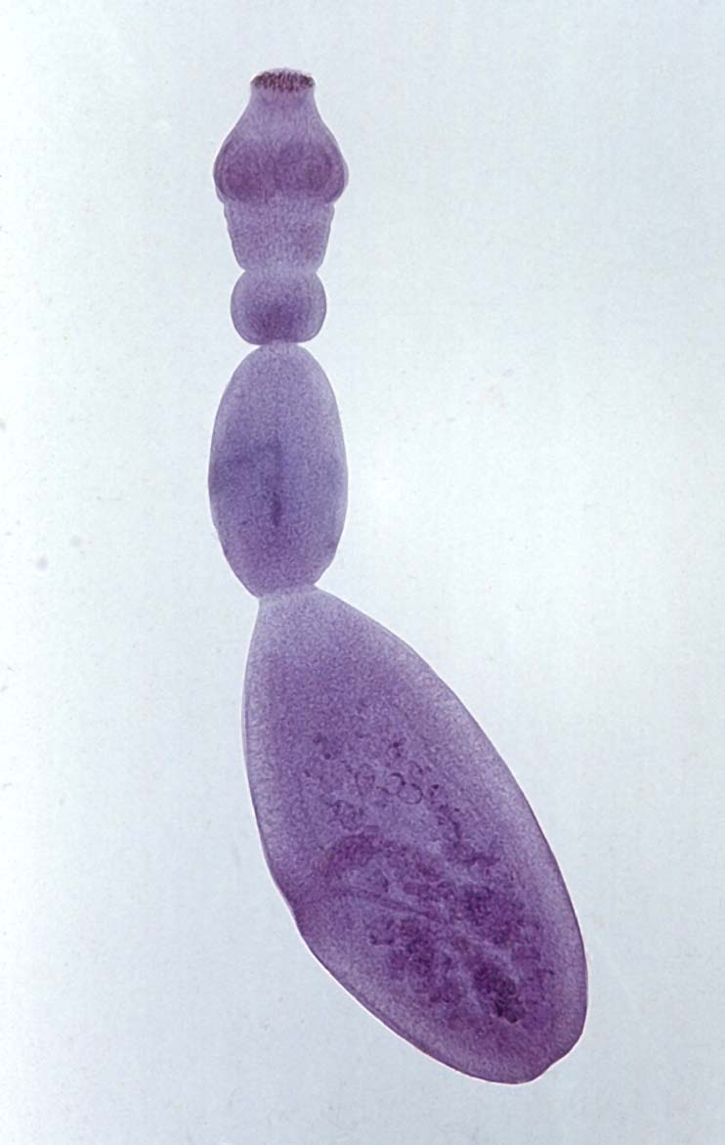
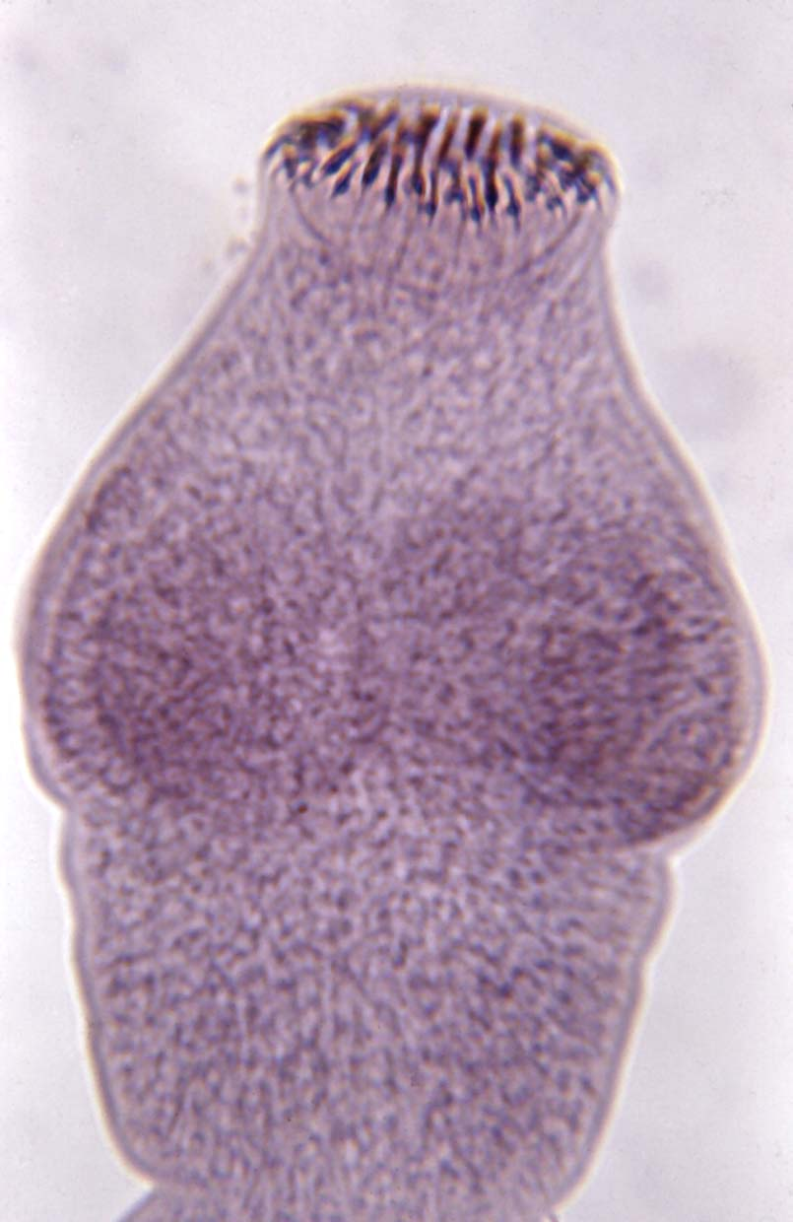
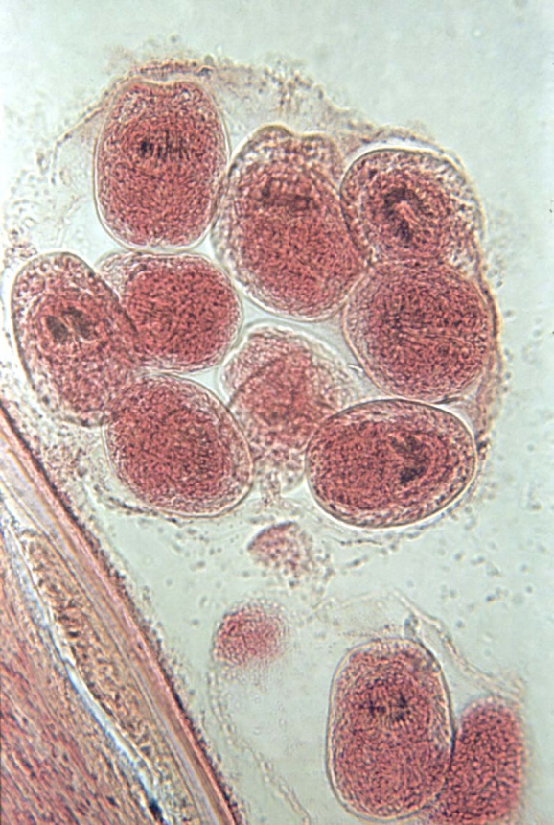
Hydatid worm, scolex and cyst

Slide 11
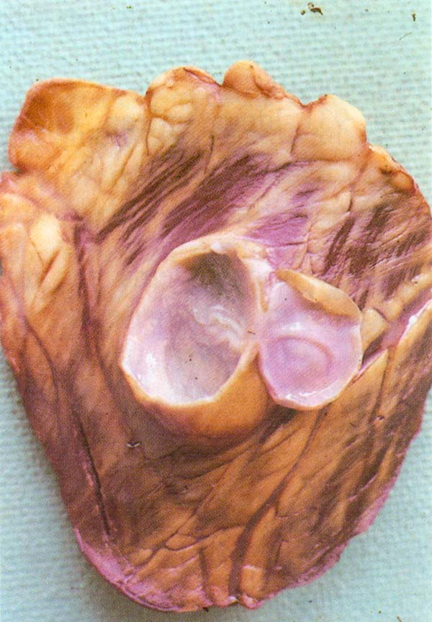
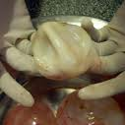
Hydatid Cysts
In a cow heart
Removed
From body

Slide 12
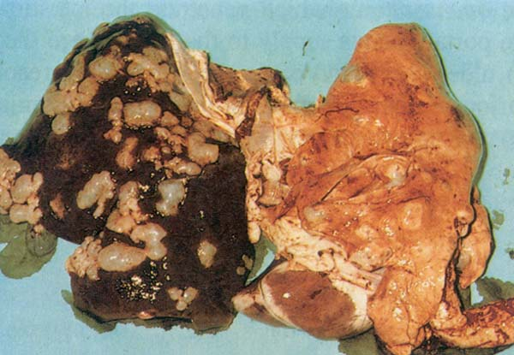
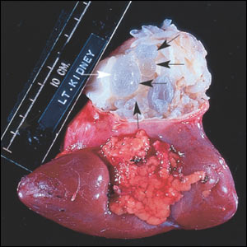
Cysts in sheep liver and human kidney

Slide 13
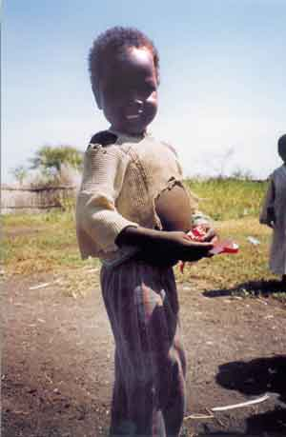
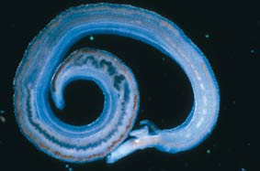

Bilharzia
Bilharzia or schistosomiasis is a debilitating disease caused by an internal parasitic worm. Part of its lifecycle is spent in water, in the snails shown below.
Worm
Snails
Sufferer

Slide 14
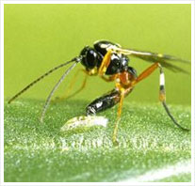

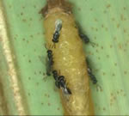
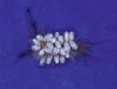
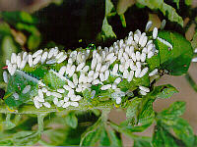
Parasitoids
These are insects (wasps or flies) who lay their eggs on or in a host. The parasitoid larvae eat the host from the inside as it grows, then emerge and pupate outside of the host.

Slide 15
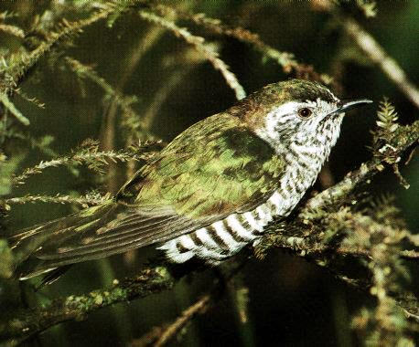
Brood parasites
The N.Z. shining cuckoo lays its eggs in the nest of a grey warbler then leaves the warblers to take care of it.
The cuckoo chick pushes other eggs & host chicks out of the nest

